Slide 1
Module 3: Software Bugs
CYBR 515: Software Security
Summer 2024
Mohammad Jamil Ahmad, Ph.D.

Slide 2
Table of Contents
Why do software fail?
Attributes of good software
Software failures
Evolution of software issues
Version Control Systems
Static code analysis demo

Slide 3
Software Dysfunction: Why Do Software Fail?
Context: Software is pervasive but often unnoticed until problems arise.
Importance: It is labor-intensive, complex, and error-prone.
Focus: The studies on eCampus explore reasons for software failures.
Also, provide guidelines on how to discover those

Slide 4
Attributes of Good Software
Functionality: Delivers required functionality and performance.
Maintainability: Easy to maintain and evolve.
Dependability: Reliable, secure, and safe.
Efficiency: Optimizes system resource usage.
Acceptability: Understandable, usable, and compatible.
Survivability: Adapts to various environments.

Slide 5
Are all software equally important?
Safety-critical: Protects human lives (e.g., medical devices, aircraft controls).
Mission-critical: Essential tasks (e.g., financial transactions, telecommunications).
Business-critical: Protects confidential information (e.g., banking, military applications).

Slide 6
What Is Software Failure?
Definition: Inability of a system or component to perform its required functions.
Concepts:
Fault/Defect: Incorrect step causing incorrect results.
Failure: System’s inability to deliver expected service.
Error: Difference between computed and correct values.

Slide 7
Classification of Failures
Unplanned Events: Crashes, hangs, incorrect or no output.
Planned Events: Scheduled system shutdowns for maintenance.
Configuration Failures: Errors due to configuration settings.

Slide 8
Causes of Software Failure
Lack of Design: Poor or no design before coding.
Inadequate Testing: Insufficient testing before release.
Attitudinal Changes: Shift from meticulous planning to “code and fix” approach.
Incompatibilities from Software Changes: Introduction of new errors.
Hostile Agent Attacks: Intentional changes to cause failure.
Unanticipated Applications: Use cases not foreseen by developers.

Slide 9
Causes of Software Failure
Complexity: Increased complexity leads to more potential for errors.
Human Error: Mistakes made by developers and users.
External Factors: Environmental conditions, cyber attacks.

Slide 10
Other Human and External Factors
Human Error: Inappropriate use, incorrect data input.
Management Laxity: Ignoring warnings due to cost concerns.
Support Systems: Dependency on reliable hardware and power.
Cyber Security: Vulnerabilities exploited by threats.
Environmental Factors: Natural disasters affecting systems.

Slide 11
Examples of Critical Software Failures
Ariane-5 Rocket: Software error leading to rocket destruction.
Therac-25: Radiation overdose causing deaths.
US Navy Ship Yorktown: Improper input leading to system failure.
Mars Climate Orbiter: Unit conversion error causing loss.
US Telephone Networks: Software issues causing network failures.

Slide 12
Evolution of Software Issues
Software Errors: Mistakes in code or logic
Syntax errors, logical errors.
Software Faults: Incorrect steps or data causing incorrect results.
Miscalculation in algorithms.
Software Failures: Inability to perform required functions.
System crashes, incorrect outputs.
Software Bugs: Flaws in the software causing unintended behavior.
Infinite loops, memory leaks.
Software Vulnerabilities: Weaknesses that can be exploited.
SQL injection, buffer overflow.

Slide 13
Comparison Table: Errors vs. Faults vs. Failures vs. Bugs vs. Vulnerabilities
Term | Definition | Cause | Impact | Example
Error | A human mistake made during software development. | Human actions (e.g., coding, design errors) | Leads to faults if not corrected. | Incorrectly implemented algorithm due to misunderstood requirements.
Fault | A flaw in the software resulting from an error. | Error in code or logic | Can cause software to behave incorrectly. | Misplaced decimal point causing incorrect calculations.
Failure | The inability of software to perform its required functions. | Activation of a fault | Results in system malfunction. | System crash due to division by zero.
Bug | An issue in the software causing incorrect or unexpected results. | Fault in the code | Affects software functionality. | Infinite loop in a program due to incorrect loop condition.
Vulnerability | A weakness in the software that can be exploited to cause harm. | Security flaw or bug | Can be exploited by attackers. | SQL injection vulnerability due to improper input validation.

Slide 14
How all of those are related to eachother?
Error to Fault: An error leads to a fault if it results in incorrect code.
Fault to Failure: A fault leads to a failure when it affects the system's functionality.
Failure to Bug: A failure is recognized as a bug when it is reported and documented.
Bug to Vulnerability: A bug becomes a vulnerability if it can be exploited.

Slide 15
How to detect each?
Detecting
Detecting Errors: Linting tools, code reviews.
Using ESLint for JavaScript.
Detecting
Detecting Faults: Static analysis tools, formal methods.
Using static analysis tools like FindBugs.
Detecting
Detecting Failures: Automated testing frameworks, continuous integration.
Using JUnit for automated testing in Java.
Detecting
Detecting Vulnerabilities: Security scanners, penetration testing.
Using OWASP ZAP for web application security scanning.

Slide 16
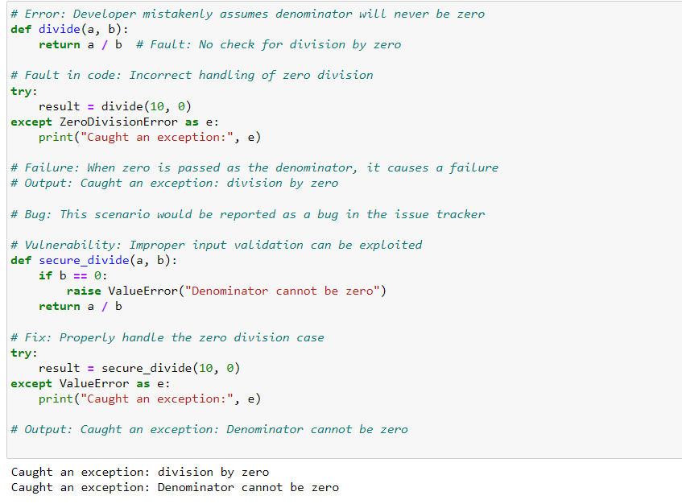
Python example

